Slide 1
Outdoor Ethics Roundtable
January
2022
A Committee! A Committee! I Need a Committee…or DO I?
Please type your name and council name in the chat.
Youth, please turn off your cameras.

Slide 2
Agenda
Welcome and opening (7:00pm Central)
Winter Activities Safety Moment
I need a committee! Or do I?—Paula Boothe
Sioux Council experience—Michelle Bierstedt
National Capitol Area Council experience—Victor Bieniek
Q&A
Adjourn (8:30 Central)

Slide 3
Pledge
I pledge allegiance to the Flag of the United States of America, and to the Republic for which it stands, one Nation under God, indivisible, with liberty and justice for all.

Slide 4
Scout Oath
On my honor I will do my best
to do my duty to God and my country
and to obey the Scout Law;
to help other people at all times;
to keep myself physically strong, mentally awake, and morally straight.

Slide 5
Scout Law
A Scout is:
Trustworthy, Loyal, Helpful, Friendly, Courteous, Kind, Obedient, Cheerful, Thrifty, Brave, Clean, Reverent.

Slide 6
Outdoor Code
As an American, I will do my best to –
Be clean in my outdoor manners.
Be careful with fire.
Be considerate in the outdoors.
Be conservation minded.

Slide 7
Please introduce yourself!
Type your name and your council’s name into the chat window.

Slide 8
We need your feedback, please!
https://tinyurl.com/OECCRT

Slide 9
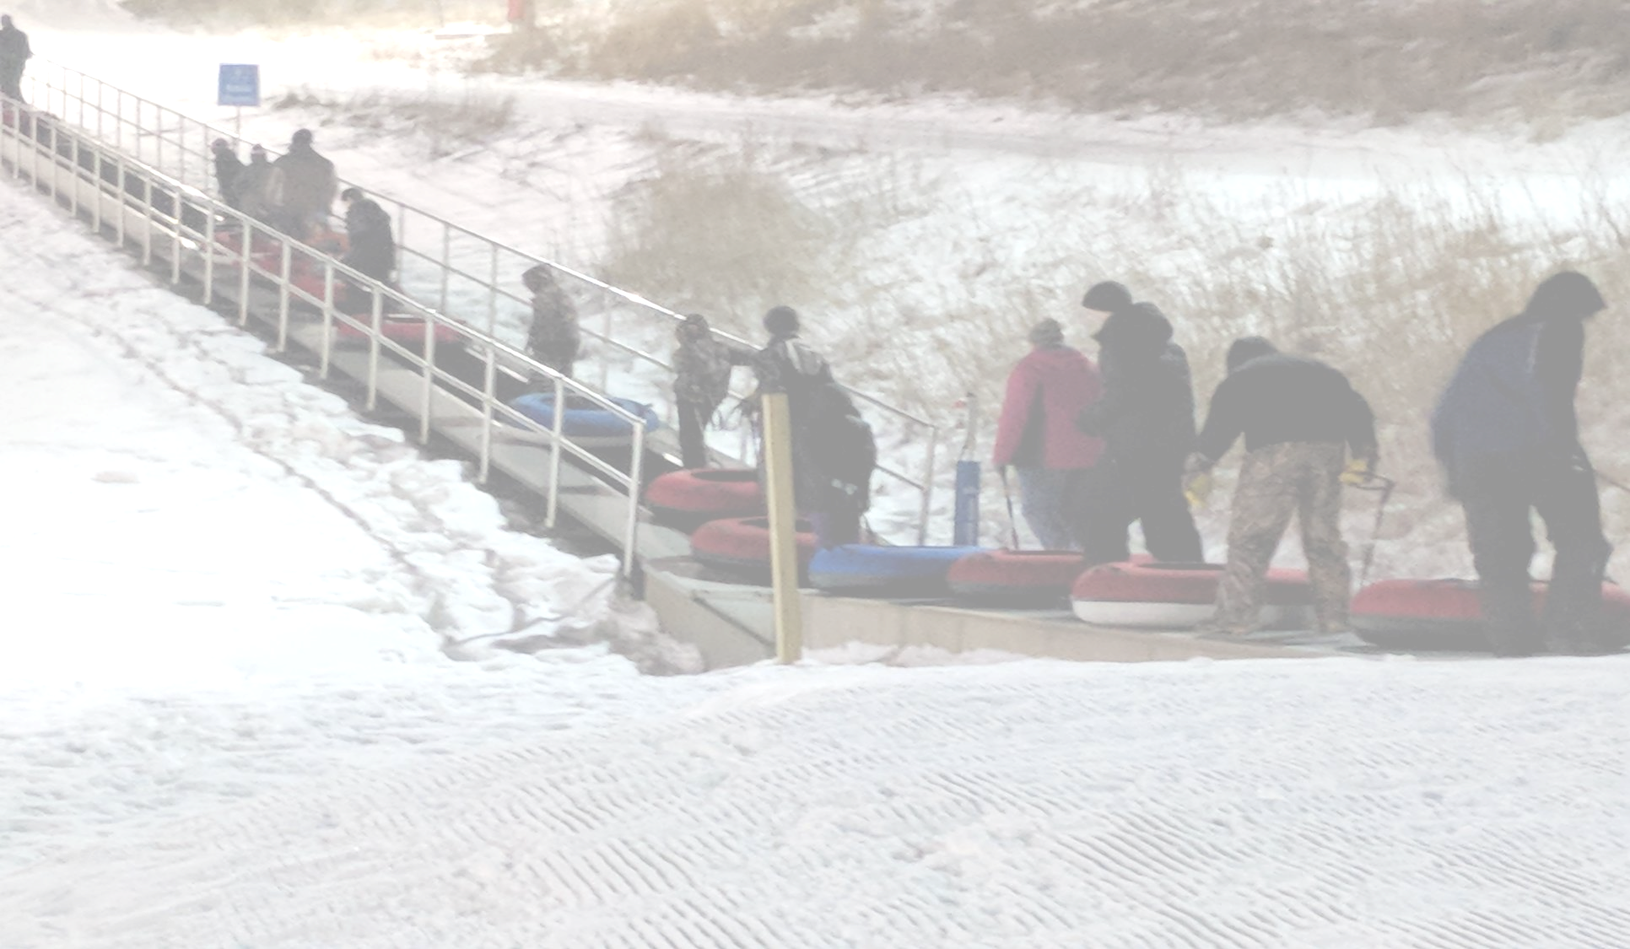
Safety Moment
Winter Activities
https://www.scouting.org/health-and-safety/safety-moments/winter-activity/

Slide 10
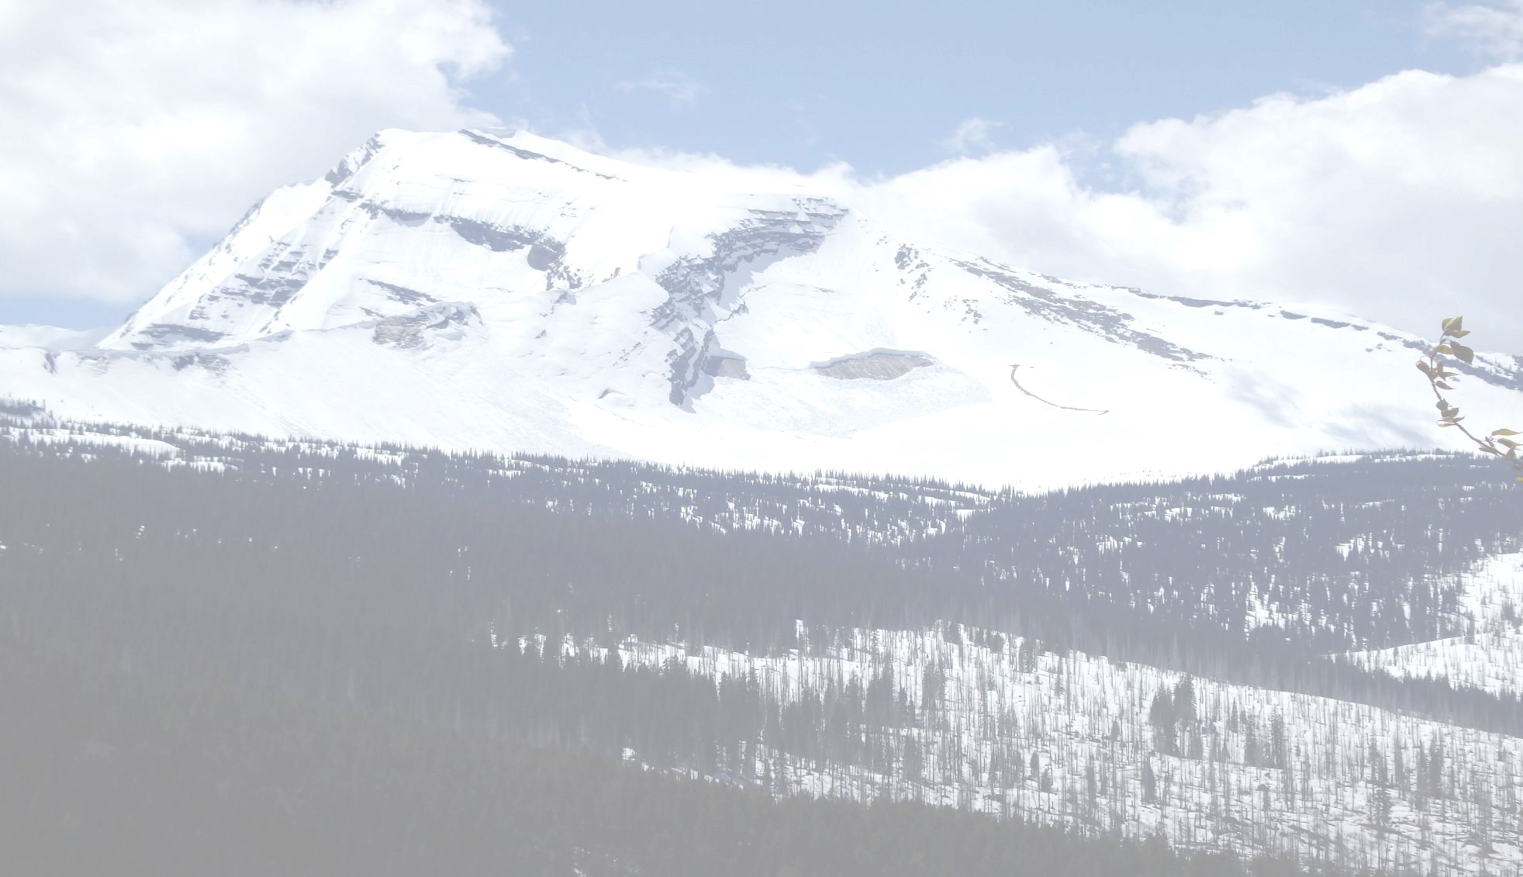
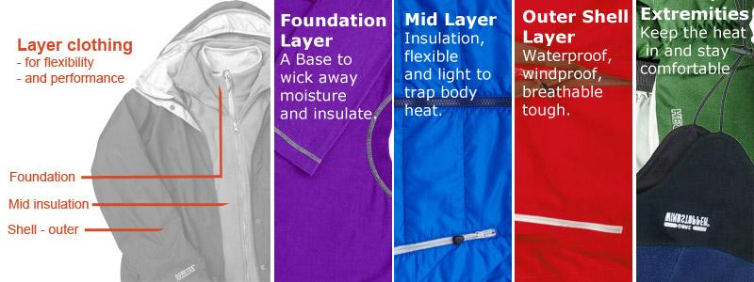
Use the “C-O-L-D” method to stay warm.
C=Clean: Since insulation is only effective when heat is trapped by dead air spaces, keep your insulating layers clean and fluffy. Dirt, grime, and perspiration can mat down those air spaces and reduce the warmth of a garment.
O=Overheating: Avoid overheating by adjusting the layers of your clothing to meet the outside temperature and the exertions of your activities. Stay hydrated by drinking plenty of water, and refrain from drinking caffeinated drinks that act as diuretics.
L=Loose layers: A steady flow of warm blood is essential to keeping all parts of your body heated. Wear several loosely fitting layers of clothing and footgear that will allow maximum insulation without impeding your circulation. Having clothing that is brightly colored (orange or red) is also a good idea, so hunters and sportsmen can see you in snowy conditions. Always have a hat and wear it.
D=Dry: Sweaty, damp clothing and skin can cause your body to cool quickly, possibly leading to frostnip and hypothermia. Keep dry by avoiding clothes that absorb moisture. Always brush away snow on your clothes before you enter a heated area. Keep clothing around your neck loosened so that body heat and moisture can escape instead of soaking through your layers.

Slide 11
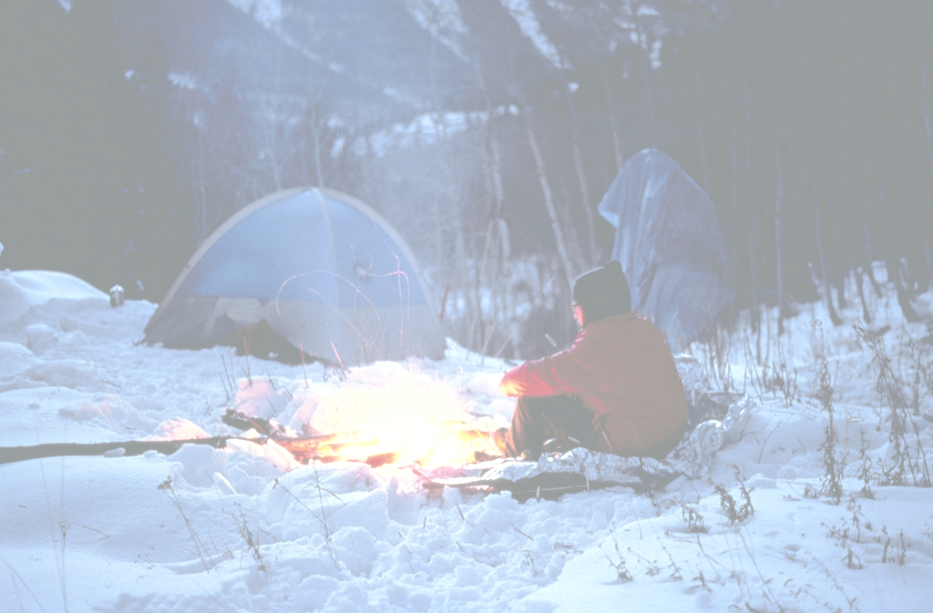
Eating the right type of food when camping or playing in the cold is important.
One of the best ways to remember what is appropriate to eat when you are spending extended periods of time outside in cold weather is to use good nutrition to build the fire within.
Make sure your food consumption includes sugars, which act like a fire starter; carbohydrates and proteins, which act as kindling; and fats that produce the energy needed to keep the fire burning and your body running at peak performance. For example, have scouts drink a glass whole milk at evening snack when the temps are below 40 degrees. The extra fat provides fuel to keep them warm through the night.
Stay away from caffeinated drinks such as soda, coffee, and tea; drink plenty of plain water to keep yourself properly hydrated.
Keep extra snacks and water in camp and in vehicles as part of your unit’s winter emergency kit.

Slide 12
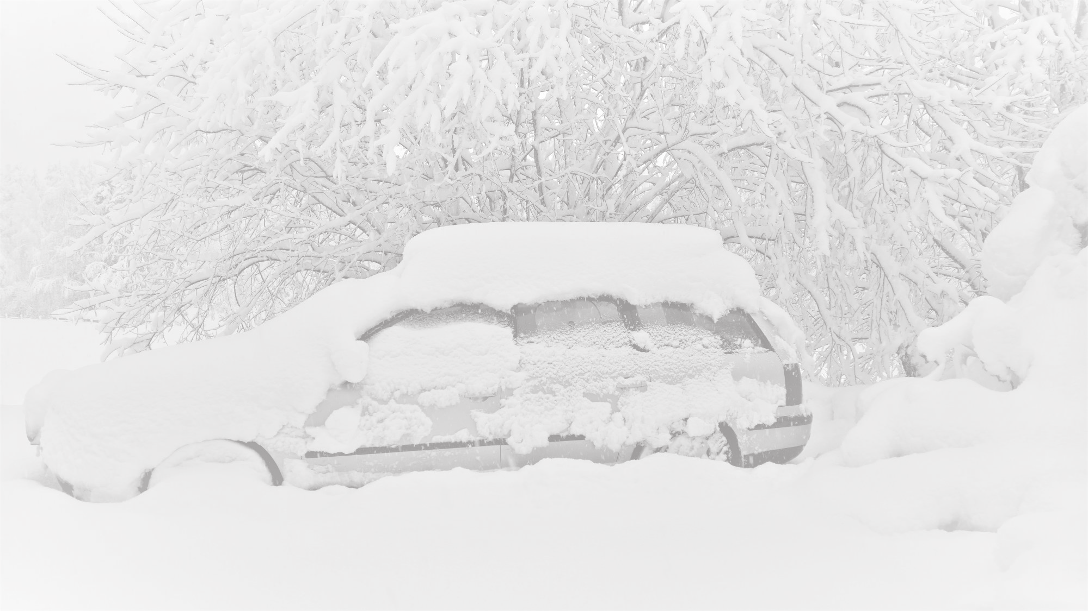
Winter emergency kits
Battery booster cables.
Ice scraper
Portable shovel. These are handy for digging out a car buried by plows or stuck along the roadside, and for clearing space around a tailpipe for extended idling, to prevent fumes from entering the car. Also, keep a bag of sand handy in your trunk to help boost traction.
Items to help if you’re stranded. A flashlight and a signaling cone or roadside triangles to warn oncoming cars of your presence. Pack backup batteries for that flashlight.
Basic first-aid kit. Be aware of how temperature may affect medicines.
Cell phone charger. Almost everyone carries a smartphone attached to the hip nowadays, and a cell phone charger is a good thing to keep in the car, especially during the winter and on road trips.
Tow strap
Water and long-lasting food
Items for handling a flat tire
Drivers should review the BSA driving in adverse weather conditions pdf before the trek (https://tinyurl.com/Jan22drivesafety)

Slide 13
A Committee! A Committee! I Need a Committee! or DO I?
roundtable@outdoorethics-bsa.org

Slide 14
Why People Volunteer

Slide 15
People volunteer because:
• They desire fun and fellowship.
• They want to feel like they are Belonging to a team.
• They wish to develop and improve their personal skills.
• They look forward to making new friends
• They seek recognition and fulfillment
• They believe in Scouting’s values and principles.
• They want to help other people.
• They want to get away from the drudgery of their work,

Slide 16
We will share how you:
Decide what you want to accomplish
Define Responsibilities
Orient and Train
Mentor - Communicate
Recognize Achievement
Evaluate Performance

Slide 17
WHY?
What is your Vision?
What is the purpose/goal?
Is there a need?

Slide 18
Define Responsibilities
Select Major Tasks
Identify Volunteers
Discuss in Person

Slide 19
Select
Consider each prospect’s skills, interests and other Relevant factors.
Fit the right person to the position.
Critical to success is the selection of quality volunteers
Who represent the values of the BSA.

Slide 20
Orient and Train
Provide each person and individual orientation on the
assignment they will cover.
Follow up soon with adequate training for all to be successful.

Slide 21
OR Not..
Members of the conservation and outdoor ethics work groups may be part of several committees when the council is smaller or by direction of the executive committee.

Slide 22
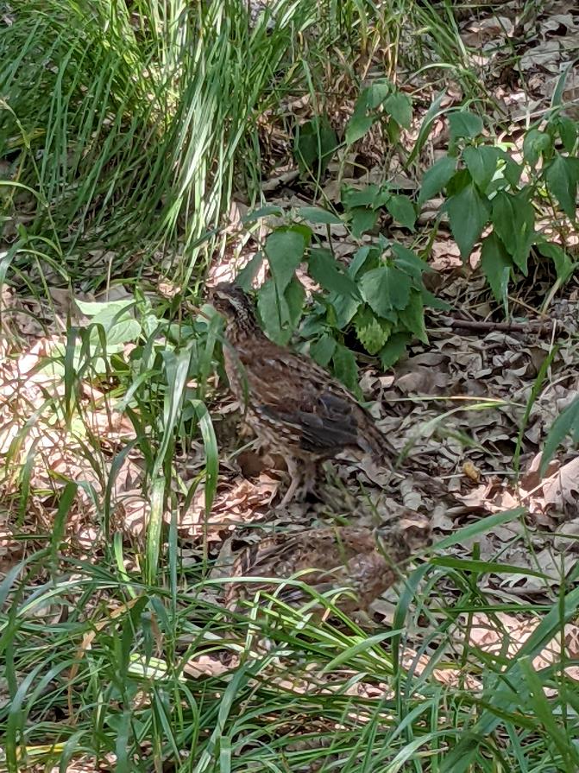
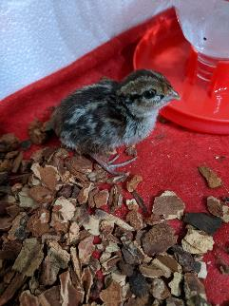
Example Sioux Council
Executive Committee
Camping Committee
Training Committee
Properties Committee
Conduct Outdoor Ethics, Leave No Trace Orientation, and STEM courses for adults and scouts at Sioux Training Academy.
Offer conservation specific High Adventure Treks
Promote Outdoor Ethics at Camp programs. Provide feedback to leaders.
Promote special awards such as DCSA
Increase number of Leave No Trace Trainers and Outdoor Ethics Guides/Advisors in the council in next 3 years
Have 6 youth/adult instructors that can do the training by 2021
Offer training at Lewis and Clark Scout Camp to staff and participants
Schedule an Awareness 101 every year
Have a Leave Outdoor Ethics Advocate Annually
Promote twice a year to those not trained in 101 directing them to the trainings
Trail improvements following conservation guidelines
Campsite development
Signage to promote leave no trace principles and minimize camp impacts.
Create camp conservation program. Review every 3 years.

Slide 23
Mentor and Communicate
Who should? ( put in chat)
Conserve volunteer time and build self esteem

Slide 24
Recognize Achievement
• Let’s hear how you recognize success, quality of service and
when?
( please put in Chat!)

Slide 25
Evaluate Performance
Help volunteers regularly evaluate themselves, evaluate the major task, subcommittee, or their group responsibility.
At least yearly you will need to do an all committee, group, or team evaluation.

Slide 26
Why Volunteers Stay in Scouting

Slide 27
• They appreciate Scouting’s role in their child’s education.
• They were given proper orientation.
• They had adequate training.
• They enjoy the opportunity to expand their horizons.
• They enjoy fellowship with other Scouters.
• They enjoy recognition for their service.
• They have FUN.

Slide 28
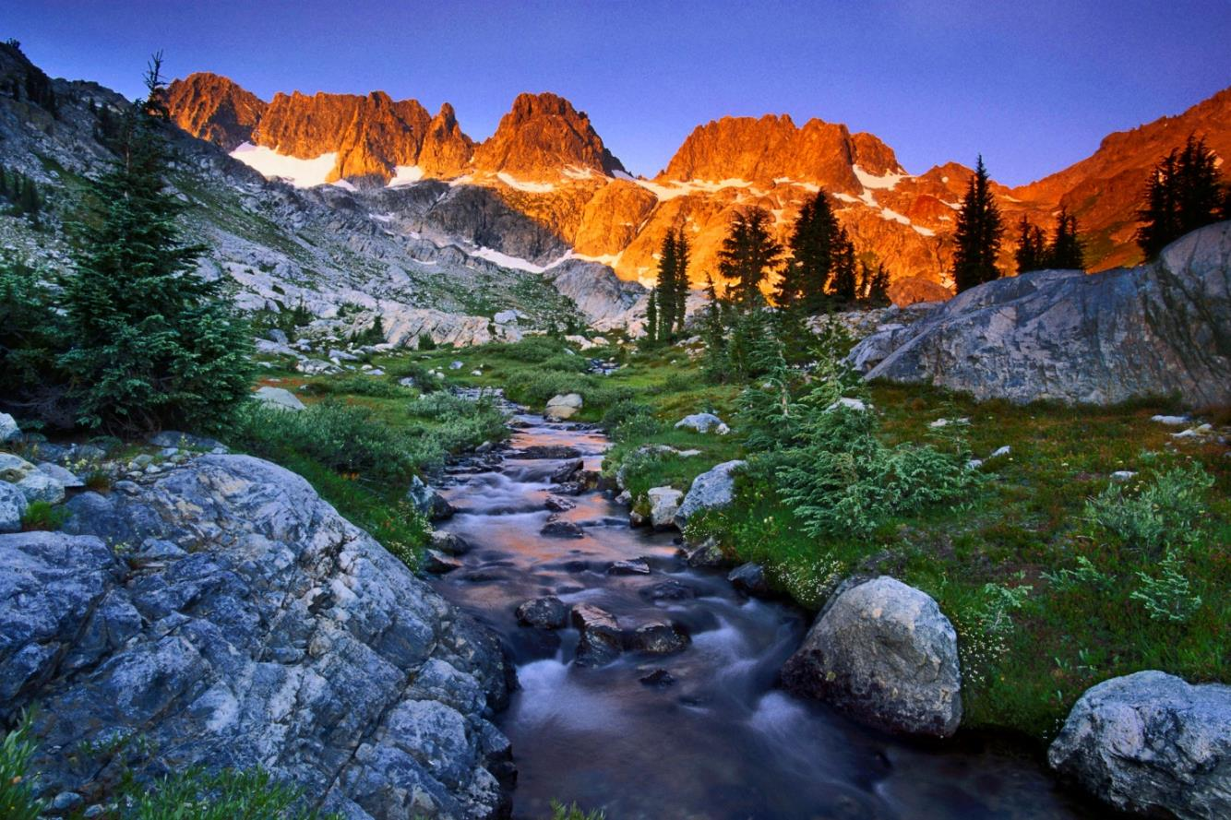
National Capital Area Council (NCAC) Outdoor Ethics Committee
Victor Bieniek
Sara Holtz
Paul Schimke

Slide 29
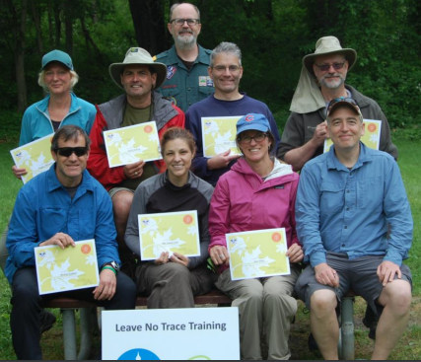
Why Create a Committee / Team?
Many hands make light work
Ability to provide a robust program
Ensure continuity / succession
Expand networking and influence
Create a community

Slide 30
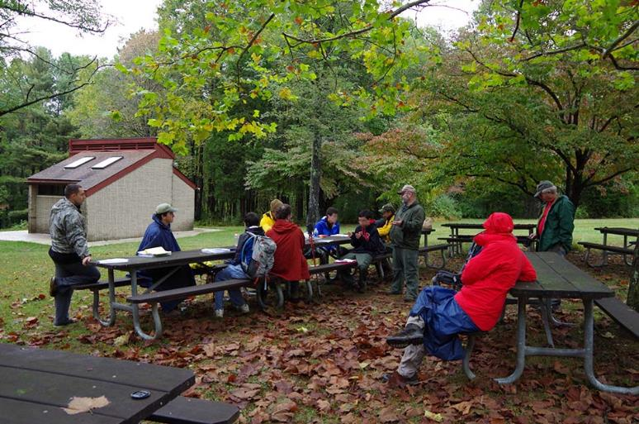
11 years ago…
We started with a group of 5 MEs
Our initial focus was to run at least two Trainer courses each year
No budget, no organization
Notes:
Chairman
Coordinates overall program
Communication
Liaison with training committee and other council committees
Volunteer recognition
Training Coordinator
Develops a council-wide training program
Receives ad-hoc requests for training
Arranges for ad-hoc training, as needed
Lead Trainers
Plans, leads, and follows up on Trainer Courses (Master Educators)
Plans, leads, and follows up on Awareness Courses (ME’s or Trainers)
Communications
Posts events on the website
Updates the website with content periodically
Sends monthly newsletters via Mail Chimp
Publicity
Writes and submits articles to Scouter Digest and other publications
Secretary
Records meeting minutes
Maintains committee list
Maintains communications list (trainers and interested parties)
Treasurer and Fund Raiser
Manages the overall budget
Solicits funds
Service Area Representatives
Providing updates at roundtables and program launch (in event there is no district representative)
District Representatives
Providing updates at roundtables and program launch
Camp Master Educator (Goshen and/or Snyder)
Offer LNT Trainer courses to staff
Teach awareness and trainer courses to adults and scouts at camp

Slide 31
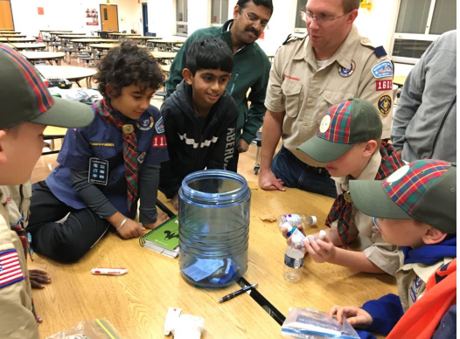
Many Hands Make Light Work
Staff Advisor
Chairman
Training Coordinator
Lead Trainers
Communications
Publicity
Secretary
Treasurer/fundraiser
District Representatives
Summer Camp Program Representative
Notes:
Chairman
Coordinates overall program
Communication
Liaison with training committee and other council committees
Volunteer recognition
Training Coordinator
Develops a council-wide training program
Receives ad-hoc requests for training
Arranges for ad-hoc training, as needed
Lead Trainers
Plans, leads, and follows up on Trainer Courses (Master Educators)
Plans, leads, and follows up on Awareness Courses (ME’s or Trainers)
Communications
Posts events on the website
Updates the website with content periodically
Sends monthly newsletters via Mail Chimp
Publicity
Writes and submits articles to Scouter Digest and other publications
Secretary
Records meeting minutes
Maintains committee list
Maintains communications list (trainers and interested parties)
Treasurer and Fund Raiser
Manages the overall budget
Solicits funds
Service Area Representatives
Providing updates at roundtables and program launch (in event there is no district representative)
District Representatives
Providing updates at roundtables and program launch
Camp Master Educator (Goshen and/or Snyder)
Offer LNT Trainer courses to staff
Teach awareness and trainer courses to adults and scouts at camp

Slide 32
Ability to Provide a Robust Program
Deliver all three levels of training
Awareness
Trainer
Master Educator
Advocacy
Roundtables
Program Launches
University of Scouting
Commissioner College
Knowledge
Website with links to references
Basecamp

Slide 33
Ensure Continuity, Succession, and Diversity
Back each other up
Recruit and mentor less experienced members
Prevent burn out
Connect with Scouting’s diverse membership base
Create next generation of Outdoor Ethics leaders

Slide 34
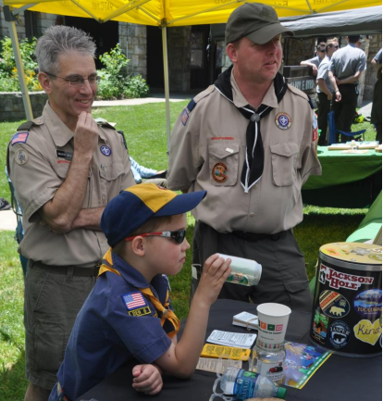
Expand Networking and Influence
Members of our committee also sit on other committees:
Training
High Adventure
Conservation
Partnerships with outside organizations:
Leave No Trace State Advocates
Potomac Appalachian Trail Club
National Park Service
Staff Advisor
Connection to council

Slide 35
Create a Community
Provide an opportunity for those of us who are committed to outdoor ethics
Means to contribute
Share information
Connect with like minded individuals
Continue to learn and grow

Slide 36
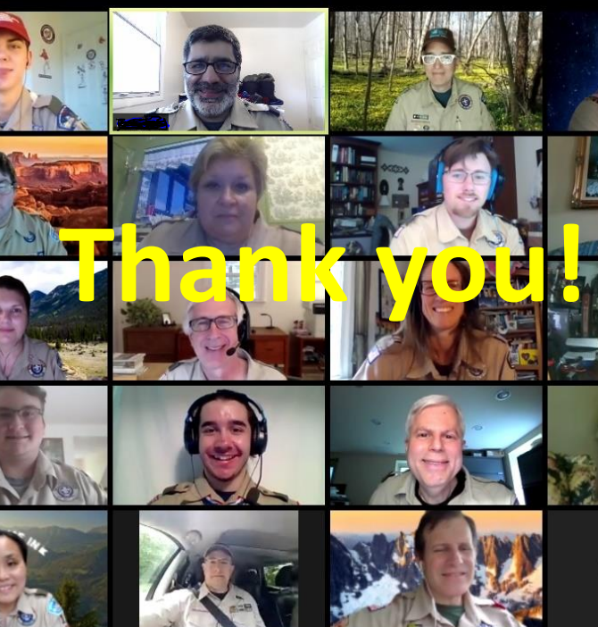
Pivot to Virtual
Committee / team of individuals allowed us to quickly pivot to virtual courses
Built upon already developed materials
Diverse skill sets
Virtual events require team of individuals to be successful

Slide 37
We will share how you:
Decide what you want to accomplish
Define Responsibilities
Orient and Train
Mentor - Communicate
Recognize Achievement
Evaluate Performance

Slide 38
Next month: The Outdoor Ethics Guide

Slide 39
2022 National Outdoor Ethics & Conservation Conference
Where Education Meets Adventure!
November 10-13
Bert Adams Scout Camp, Covington, Georgia
Check http://outdoorethics-bsa.org for updates!

Slide 40
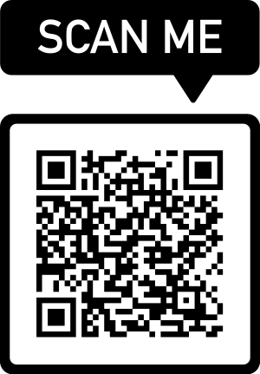
Please consider a gift to the Dan Howells Memorial Fund
We lost a good an passionate friend on October 24th. Among the many footprints he left are the Master Educator courses he taught and his significant contributions to developing Master Educator training in the BSA.
Remembrances can be made in Dan’s memory to a scholarship fund for Leave No Trace Master Educator Course attendees. Partial scholarships will be awarded to BSA members.
https://lnt.org/give/other-ways-to-give/dan-howells-memorial-fund/

