Slide 1
Outdoor Ethics
Virtual Roundtable
December 2, 2020
Mark Hammer
BSA Outdoor Ethics Subcommitee
OutdoorEthics-BSA.org webmaster
Notes:
Council Outdoor Ethics Advocates are vital!
Your Important Responsibilities:
Recruiting - Building Your Committee
Teaching
Promoting
Reporting
Discuss some ways we can support YOU!
(Many of you are already familiar with much of this)

Slide 2
Outdoor Ethics Advocate Reporting
BSA OE Virtual Roundtable
Dec 2, 2020
Mark Hammer
BSA Outdoor Ethics Subcommitee
OutdoorEthics-BSA.org webmaster

Slide 3
Welcome!
Council Outdoor Ethics Advocates and their teams are vital!
Your Important Responsibilities:
Discuss some ways we can support YOU!
  (Many of you are already familiar with much of this)
  Recruiting
  Teaching
  Building Your Committee
  Promoting
  Reporting

Slide 4
Terminology - Abbreviations
OE – Outdoor Ethics
OEA – Outdoor Ethics Advocate
  COEA – Council Outdoor Ethics Advocate
  AOEA – Area Outdoor Ethics Advocate
  ROEC – Region Outdoor Ethics Coordinator
OEE – Outdoor Ethics Educator
ME – Leave No Trace Master Educator
MTT – Tread Lightly! Master Tread Trainer

Slide 5
Agenda
COEA Reporting Responsibilities
Background - BSA OE Contacts Database
Reporting – Your OE Advocate Tools
  Annual Reporting
  Verifying Your Council OE Contacts
  Event Reporting Tool
  Event Registration Tool
Q & A

Slide 6
COEA Reporting Responsibilities
OutdoorEthics-BSA.org/files/COEA_Responsibilities.pdf:
Collects information about OE programs conducted in the local council and reports to the National OE Subcommittee annually.
Reports progress to the AOEA as specified.
Oversees the proper reporting of training courses within the local council and keeps a data base of OEE’s who become part of the OE Committee or Team.
Ensures that the listing of Leave No Trace Master Educators . . (OutdoorEthics-BSA.org/contacts) is up to date.

Slide 7
Agenda
Review COEA Reporting Responsibilities
Background - BSA OE Contacts Database
Reporting – Your OE Advocate Tools
  Annual Reporting
  Verifying Your Council OE Contacts
  Event Reporting Tool
  Event Registration Tool
Q & A

Slide 8
BSA OE Contacts
Secure online database
  Maintained by BSA OE Subcommittee
  Not tied to BSA Membership database
People: OE Advocates, Leave No Trace MEs, (MTTs), Others interested in BSA OE
Supports:
  Scouters finding key active OE Contacts in their council (or nearby)
  BSA OE Subcommittee, ROECs, AOEAs, COEAs communication -- news and updates.
  OEA access to your OE Contacts, Annual Reports, Events

Slide 9
BSA OE Contacts
Keeping It Up-To-Date
We depend on our OE Community for updates
Individuals
  Update your own Contact Info
  Other - Let us know: updates@outdoorethics-bsa.org
  Bulk Email to “Unverified” Contacts
COEAs, AOEAs, ROECs

Slide 10
OutdoorEthics-BSA.org Database
Other Information
People / Roles
Annual Reporting Data
  Event Reporting
Councils (Districts) / Areas / Regions
ME Course History
  ME Instructors
COEA Training & Event (OE Conference) Attendance
Event Registration Data
Center Database Comparison

Slide 11
OutdoorEthics-BSA.org Database
Public Information (Listed on website for anyone)
  Per-Council OE Contacts (MEs/OEAs), AOEAs, OES, . . .
  Name, Council, City, Role
  Email and Phone - If We Have Permission to List
Confidential Information(Limited Access, Need to Know Basis)
  Additional People Info: Emails and Phones, Status
  Councils’ Annual Reports, Event Reporting
  OEAs can access this through OEA Tools
Other Private Information is further restricted

Slide 12
Agenda
Review COEA Reporting Responsibilities
Background - BSA OE Contacts Database
Reporting – Your OE Advocate Tools
  Annual Reporting
  Verifying Your Council OE Contacts
  Event Reporting Tool
  Event Registration Tool
Q & A

Slide 13
Annual OE Report
COEAs are asked to report at the end of each calendar year.
  Report form available in Nov, please submit by late January.
OE Subcommittee uses the information to assess progress/status of OE & Leave No Trace across the BSA.
  Which Councils are doing well and where more support is needed.
  Overall progress / trends in Leave No Trace education.
Summary is included in OES annual reports to the Leave No Trace Center and to the BSA Outdoor Program Committee.
    Thank You for taking the time to REPORT the Outdoor Ethics progress in your council!

Slide 14
Annual OE Report
What are the survey questions?
  (Little change in the past several years.)
  See the form: OutdoorEthics-BSA.org/AnnualReport
Submit the info you know, then go back to the form and add more data as you get it.
Area OEAs, Region OECs, OES can see what has been submitted (& follow-up).
How to gather the data?
  Keep records, and poll your MEs and Trainers.
  Don’t wait until the end of the year.
  (There is a tool to help!)
Questions?

Slide 15
OEA Tools - Functions
Council OE Advocates:
  Contact info for your MEs and MTTs.
    Verify/Remove
  Your Annual Report(s)
  Event Reporting Summaries (COEA Opt-In)
  Event Registration Admin (COEA Opt-In)
Area OE Advocates:
  Contact info for your Councils’ COEAs, MEs and MTTs.
    Verify/Remove
  Annual Reporting status overview and details for your Councils.

Slide 16
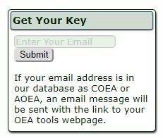
OEA Tools - Access
OutdoorEthics-BSA.org/OEAtools
Get your Key
  Use the form to request your key.
  You will receive an email with the link.
  Bookmark the page.

Slide 17
Council OEA Tools

Slide 18
COEA Tools –
Contacts & Verification
Contact info for your COEA, MEs, MTTs
May include non-public emails, phones.
Maintain Confidentiality!
(blurred for these slides)

Slide 19
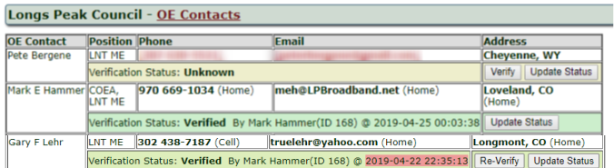
Verify Contact Status

Slide 20
Not Verified?

Slide 21
COEA Tools
Your Contacts, Verify
Any Questions?

Slide 22
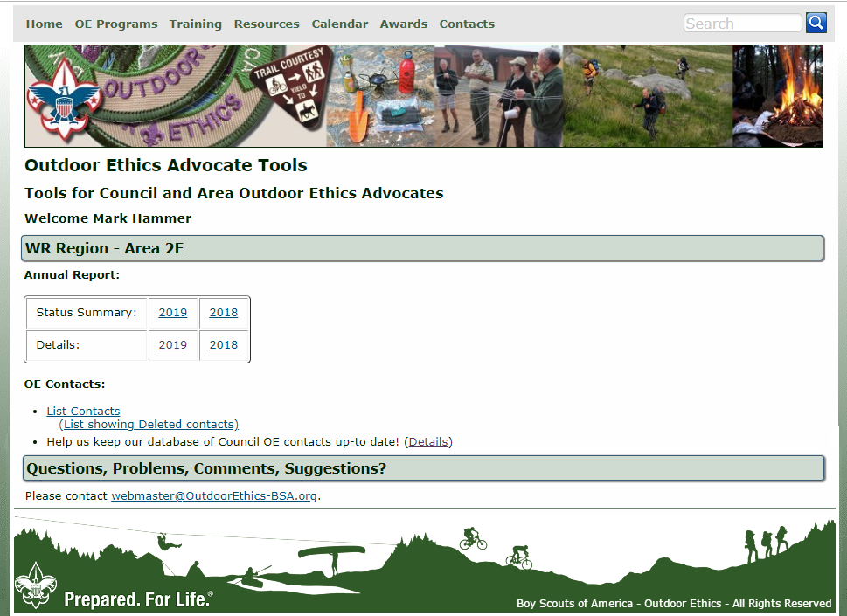
Area OEA Tools

Slide 23
AOEA Tools
Contacts & Verification
Same as COEA Contacts, except you see all your Councils.
Maintain Confidentiality!
(blurred for these slides)

Slide 24
AOEA Tools
Annual Report Status

Slide 25
Agenda
Review COEA Reporting Responsibilities
Background - BSA OE Contacts Database
Reporting – Your OE Advocate Tools
  Annual Reporting
  Verifying Your Council OE Contacts
  Event Reporting Tool
  Event Registration Tool
Q & A

Slide 26
COEA Tools
Event Reporting
You, Your Trainers & MEs
You (COEA) Only
Event Report
+ Roster Entry
Admin Access:
Events Summary,
Event Details,
Training Attendance Reports,
Trainer Course Submission,
Data Summary for Annual Report
Event Report
Your
Event DB
Event Report (+ Roster Import)
. . .
Event Report

Slide 27
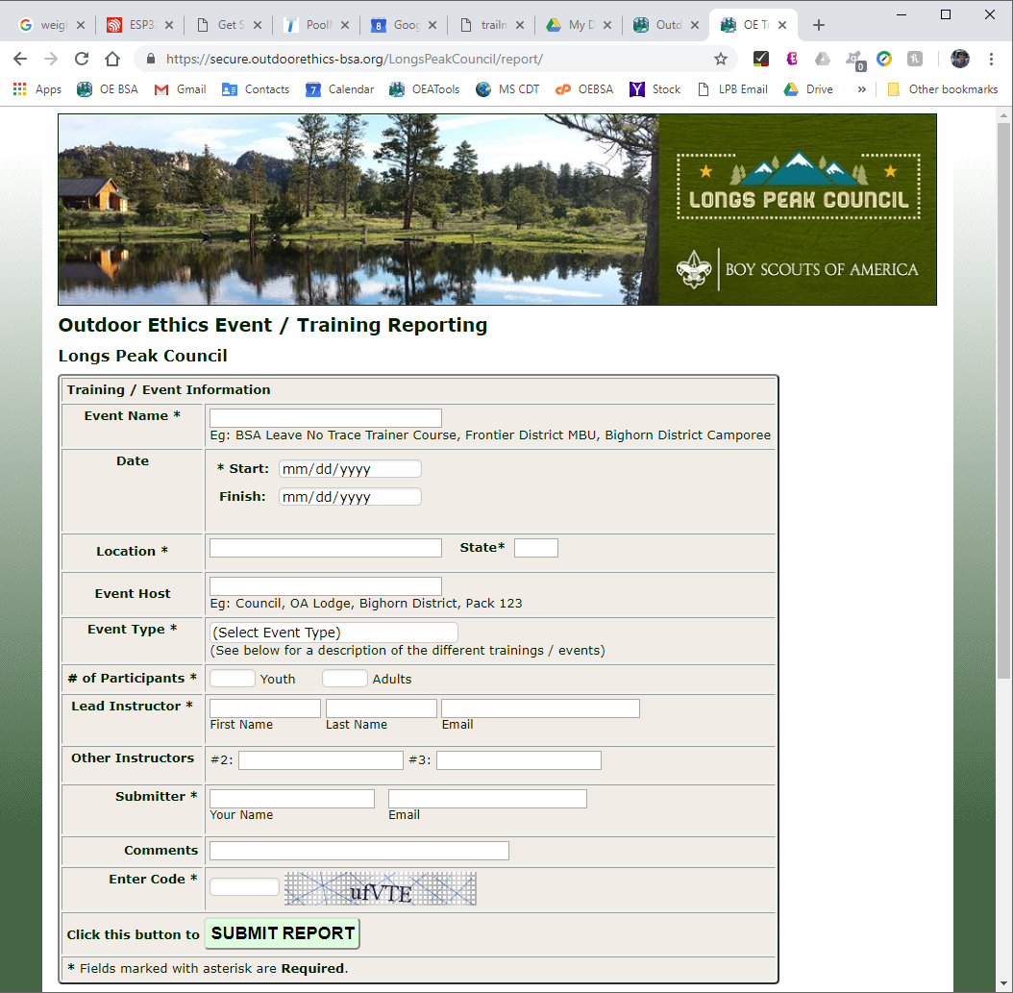
COEA Tools
Event Reporting
Have your MEs & Trainers report their events using your council form.
Now for 2020 (or past).
Ongoing for future.
More Info
Try It - Demo

Slide 28
COEA Tools
Event Reporting
Same categories as Annual Report (plus optional ones, configurable)

Slide 29
COEA Tools
Event Reporting - Roster
Roster Entry is Optional
  For Courses w/ Training Attendance Report
  For Leave No Trace Trainer course – Center Roster submission

Slide 30
COEA Tools
Event Reporting
You, Your Trainers & MEs
You (COEA) Only
Secondary Contact also has access.
We can set up someone else on your OE committee if you want to delegate this.
Event Report
+ Roster Entry
Admin Access:
Events Summary,
Event Details,
Training Attendance Reports,
Trainer Course Submission,
Data Summary for Annual Report
Event Report
Your
Event DB
Event Report (+ Roster Import)
. . .
Event Report

Slide 31
Council OEA Tools

Slide 32
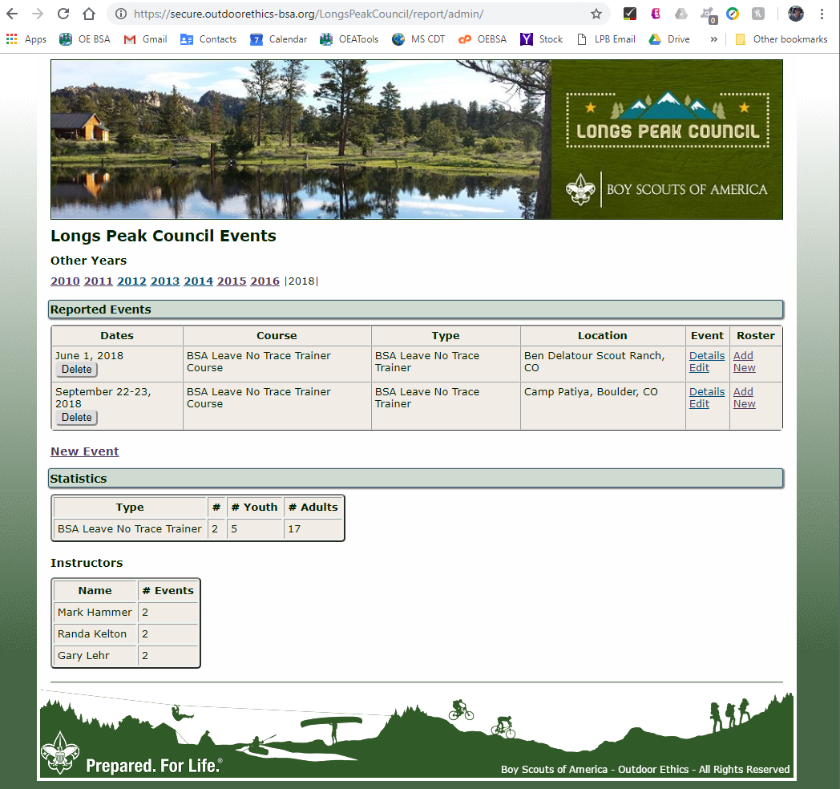
COEA Tools
Admin - Event Reporting
Summary page for the COEA
Reported Events, by Year
(See Demo)

Slide 33
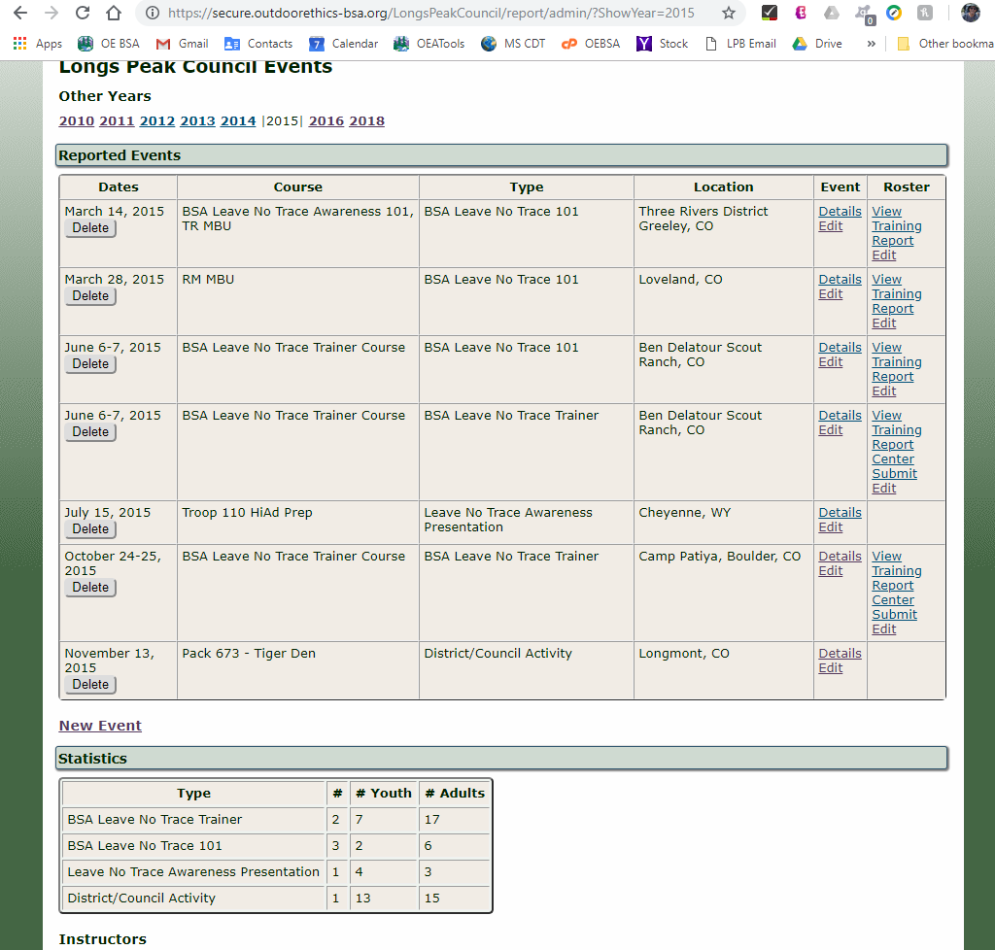
COEA Tools
Event Summary
Another Example with more reported Events
View/Edit Event/Roster
Links to create Training Attendance Report, and Center Roster submission
Summary for your Annual Reporting

Slide 34
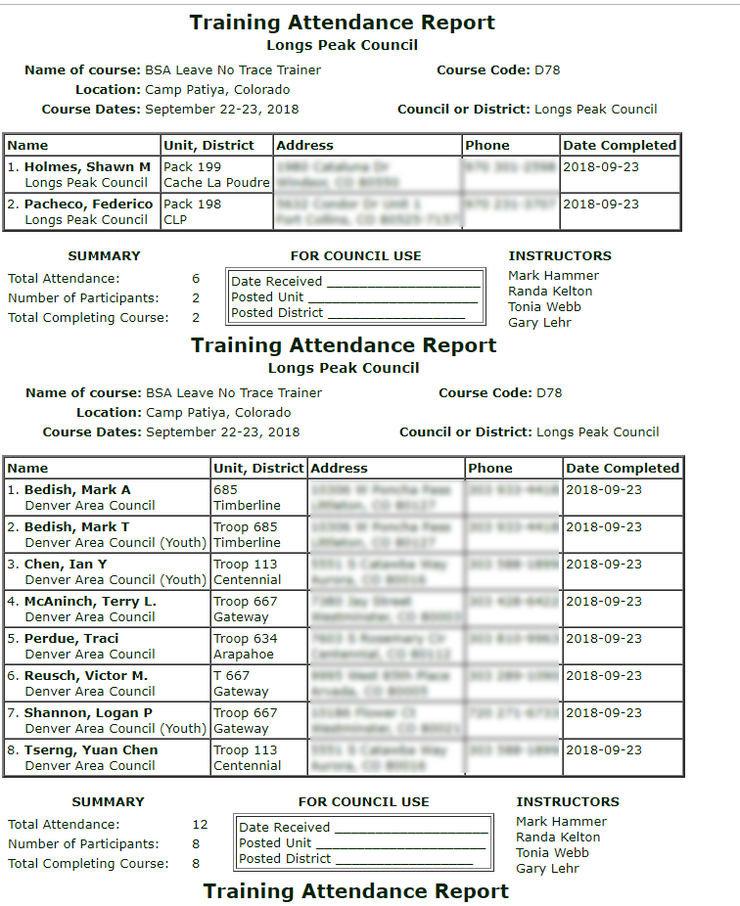
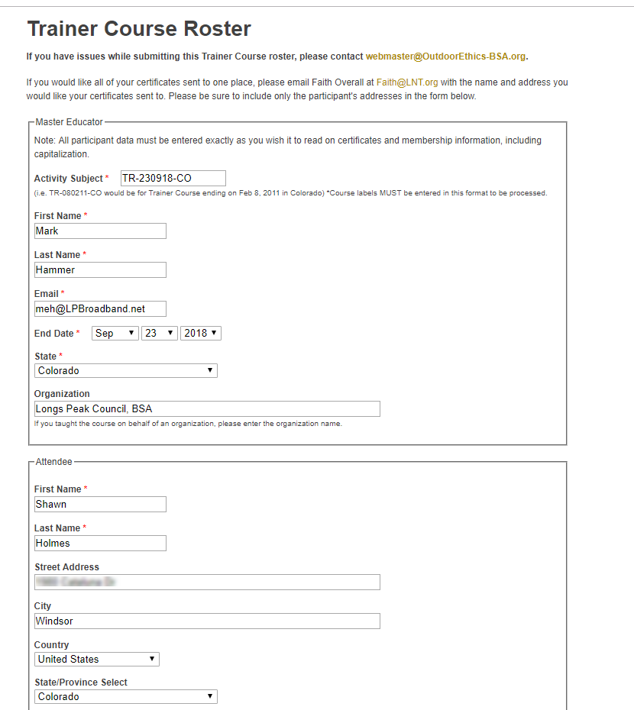
COEA Tools
Events - Reports

Slide 35
COEA Tools
Event Reporting
Event Reporting is optional and must be requested by the COEA.
Email the Webmaster if you would like to use these tools for your council:
  Mark Hammer
  webmaster@OutdoorEthics-BSA.org
  970 669-1034
Questions on Event Reporting?

Slide 36
COEA Tools
Event Registration
Training Participants
You (COEA) Only
Register (& PayPal)
Admin Access:
Registration List, Edit/Export
Training Attendance Reports,
Trainer Course Submission
Register
Your
Event DB
Register & Mail Payment
. . .
Register

Slide 37
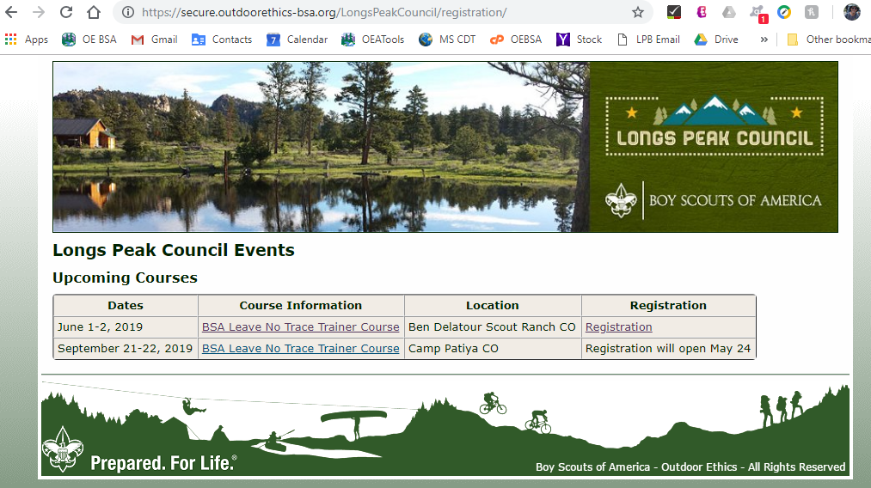
COEA Tools
Event Registration

Slide 38
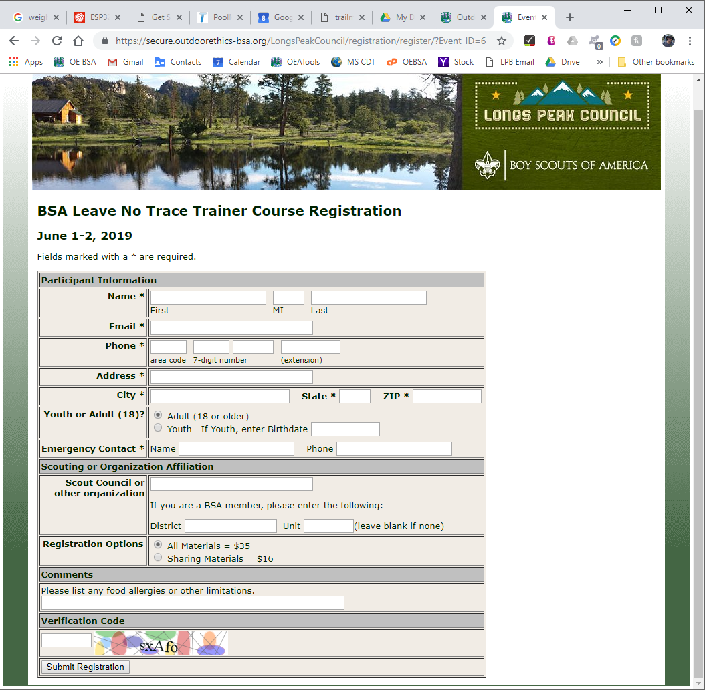
COEA Tools
Event Registration Form

Slide 39
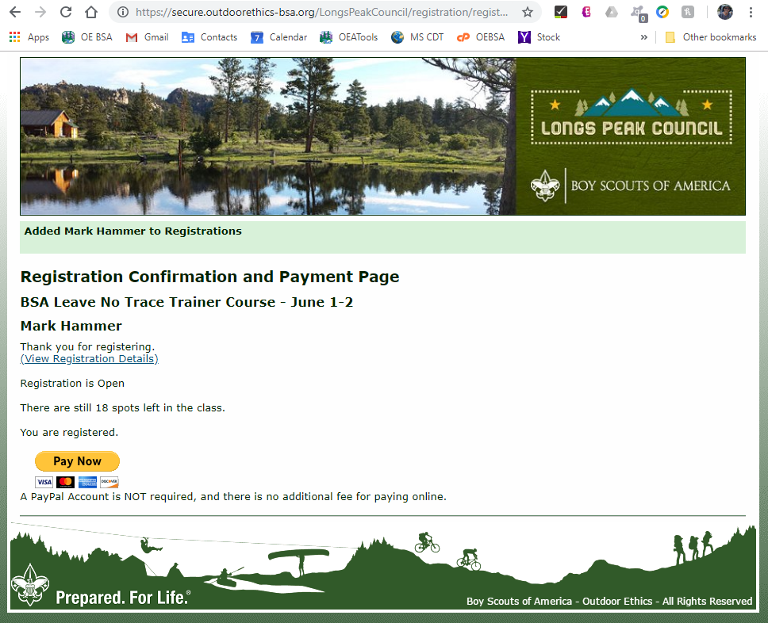
COEA Tools
Event Registration - Payment
Online Payment through a PayPal account (Optional)

Slide 40
COEA Tools
Event Registration
Training Participants
You (COEA) Only
Register (& PayPal)
Admin Access:
Registration List, Edit/Export
Training Attendance Reports,
Trainer Course Submission
Register
Your
Event DB
Register & Mail Payment
. . .
Register

Slide 41
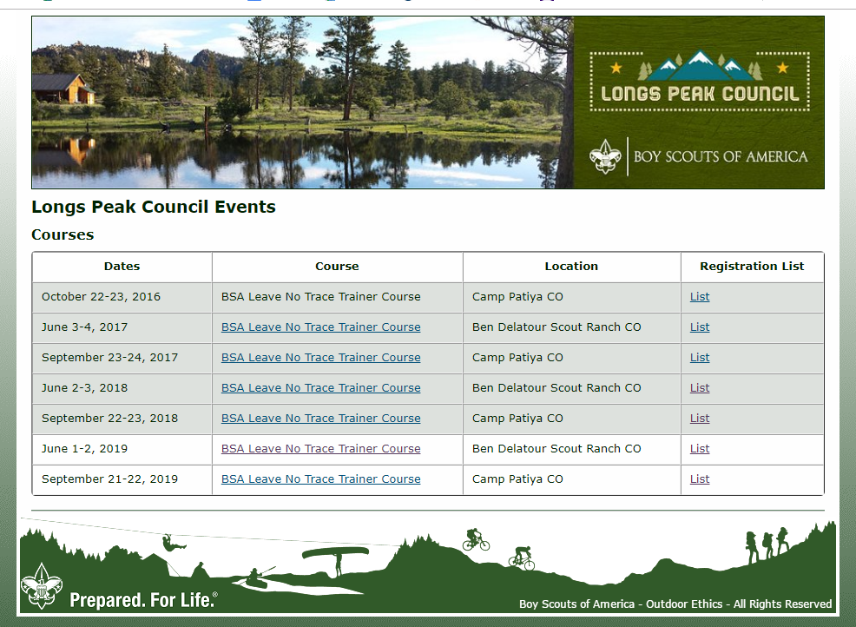
COEA Tools
Event Registration - Admin
Admin Levels – Overall / Event

Slide 42
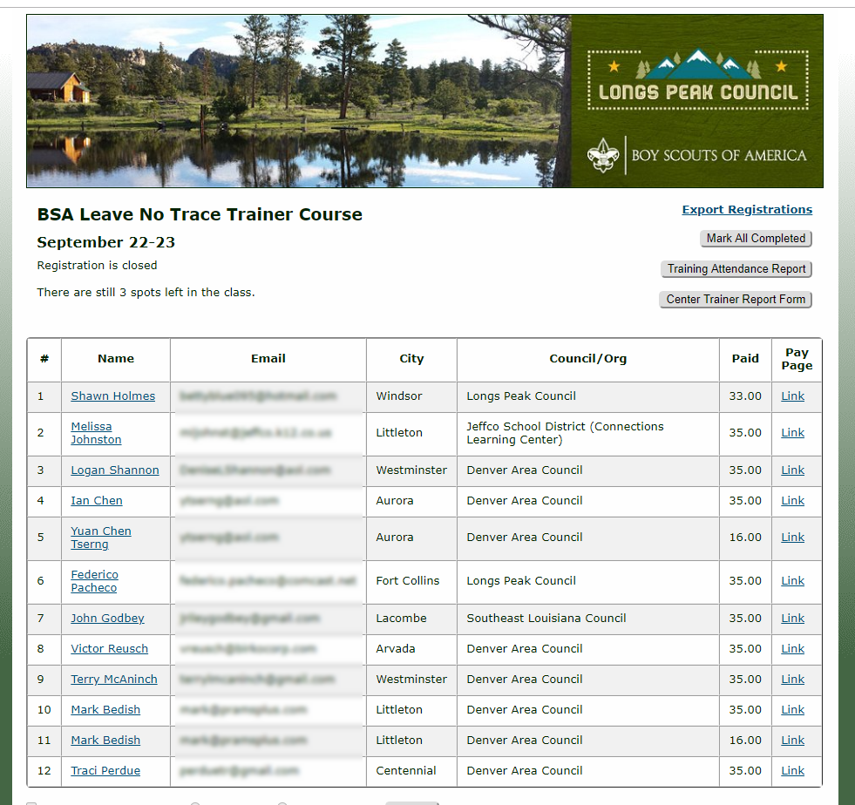
COEA Tools
Admin - Event Registration
Registration Summary

Slide 43
COEA Tools
Event Registration - Reports

Slide 44
Council OEA Tools

Slide 45
Council OEA Tools
Event Registration is optional and must be requested by COEA.
Contact the Webmaster if you would like to use this tool for your council:
  Mark Hammer
  webmaster@OutdoorEthics-BSA.org
  970 669-1034

Slide 46
OEA Tools
Lots of Detail, but not complicated.
  My Goal is to keep them simple & easy to use.
  Try the tools, contact us with questions.
  (Don’t get stuck and frustrated.)
Questions, Suggestions, Comments
  Contact Mark Hammer
  webmaster@OutdoorEthics-BSA.org

Slide 47
OEA Reporting Tools
Your work as OEA is valuable.
We count on you for Reporting – Annual and Contacts
Paula, Marshall & Toby encourage you to use the tools – makes your job and theirs easier.
Questions ?

Slide 48
BSA OE Virtual Roundtables
Upcoming Virtual Roundtables
  January – Short Term Camp Overnight Trainings
  February – Women Outdoors
Roundtable Feedback and Suggestions:
Paula Boothe - towonuni@aol.com

Slide 49
BSA OE Virtual Roundtable
Thank You for Attending our Roundtable
Thanks to Paula Boothe, Scott Anderson & crew

